Slide 1
BLUETOOTH ROBOTICS

Slide 2
CONTENTS
What is Bluetooth Controlled Robotics?
Materials Required
Circuit Diagram
Working Explanation
Application

Slide 3
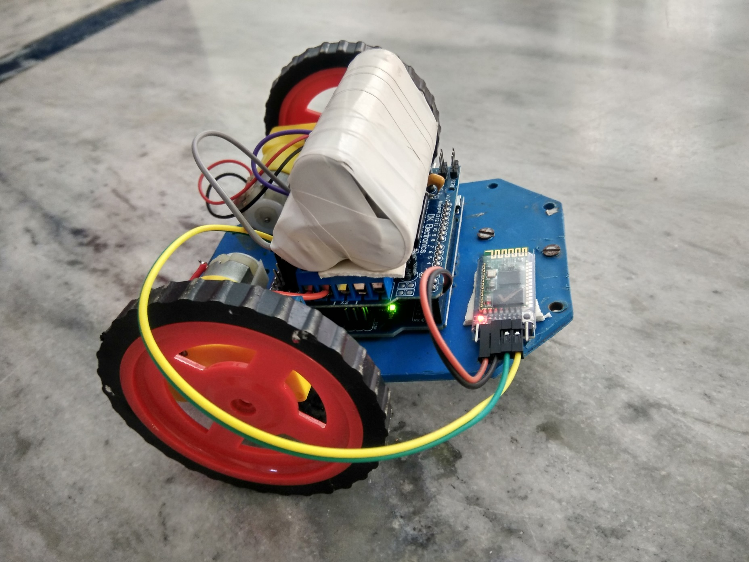
What is Bluetooth Robotics?
Bluetooth Controlled Robotics involves the operation of Robots in accordance with the signals sent from a smart phone using an Android Application and Bluetooth Communication.

Slide 4
MATERIALS REQUIRED
1. Bread board 2. HC-05 Bluetooth module 3. Jumper wires or breadboard wires 4. Arduino 5. Two 500 rpm motor 6. Two 9v batteries 7. L293D 8. Chassis 9. Wheels 10. Android mobile

Slide 5
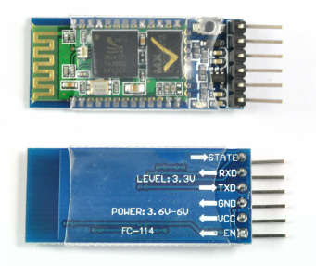
BLUETOOTH MODULE
HC‐05 module is an easy to use Bluetooth SPP (Serial Port Protocol) module, designed for transparent wireless serial connection setup.

Slide 6
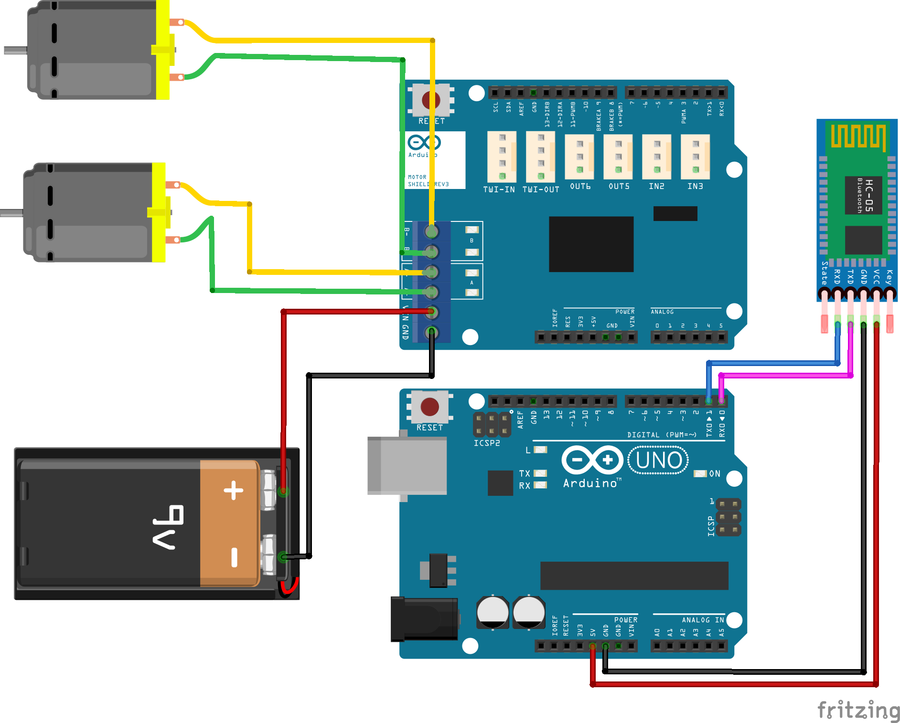
CIRCUIT DIAGRAM

Slide 7
WORKING EXPLANATION
ARDUINO
DC
Motor
Bluetooth
Module
(HC-05)
MOTOR
DRIVER
DC
Motor

Slide 8
APPLICATION
Bluetooth
Receiver
Android Phone
Arduino
Android Robot Control
Motor Driver
Motor1
Motor 2

Slide 9

THANK YOU

